Slide 1
KNOWLEDGE AND PRACTISES REGARDING H1N1 INFLUENZA
AMONG PREGNANT MOTHERS ATTENDING POLY CLINICS
IN CHILAW MOH AREA
W.SANKA DILSHAN FERNANDO
Matrix Number: 072019070002
Faculty of Life and & Health sciences
Management and Science
University

Slide 2
Contents:
Chapter 1 - Introduction
Chapter 2 - Research Methodology
References

Slide 3
Chapter 1 - Introduction
Background of the study
Justification
Research Objectives
Significance of the study
Limitation of the study

Slide 4

Chapter 1 - Introduction
Background of the Study
H1N1 - orthomyxovirus
H1N1 virus results - non-febrile, mild upper respiratory tract infection to severe or fatal pneumonia
Symptoms - sudden fever (typically >38 °C) vomiting, and/or diarrhea, runny nose, cough, fever, sore throat and headache can also be there (Fujardo-dolci et al., 2012)
High risk groups - pregnant women, infants and young children <2 years of age (WHO, 2010)

Slide 5
Chapter 1 - Introduction
Background of the Study
In Thailand
39% of pregnant women had never heard of the influenza (Ditsungnoen et al., 2016)
In South Africa
55.5% believed that influenza is the same as common cold
57.2%. participants had heard of the vaccine to prevent influenza. (Olatunbosun, Esterhuizen and Wiysonge, 2017)
In Eastern china
One in five older adults was aware of the influenza virus (21%) or vaccine (20%); (Wendlandt et al., 2018)

Slide 6
Chapter 1 - Introduction
Justification
As pregnant women are at increased risk for severe disease and has a potential in spontaneous abortion or death
Up to 3rd week of May 2015, reported and confirmed 252 H1N1 cases with six deaths among pregnant women (Seasonal Influenza report 2015)
Influenza A (H1N1) vaccine, not been established in clinical trials in pregnant women yet in Sri Lanka
Two peaks in Sri Lanka for influenza
May/June/July
November/December and January
(Seasonal Influenza report 2015)

Slide 7
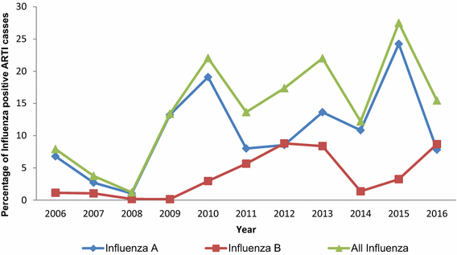
History and current trends in influenza virus infections with special reference to Sri Lanka
Justification cont.
https://link.springer.com/article/10.1007/s13337-017-0390-8

Slide 8
Chapter 1 - Introduction
Significance of the Study
To provide an idea about the topic to Public Health Sector
The findings of this study will aid medical officers, health administrators and health policy planners to build upon health education programs on influenza
There is no immediate benefit to participants of this study; however, answering the questionnaire may create interest among participants to be knowledgeable about this field

Slide 9
Chapter 1 - Introduction
Limitations of the study
Focus is only pregnant mothers who attend to the polyclinics in Chilaw MOH area
Depend on responder, might provide socially desirable answers
Designing the questions will also influence its results and conclusions

Slide 10

Chapter 1 - Introduction
Objectives of the Study
General Objective
To determine the knowledge and practices regarding H1N1 Influenza among pregnant mothers attending polyclinics in Chilaw MOH area

Slide 11
Chapter 1 - Introduction
Objectives of the Study
Specific Objectives
To access the knowledge
To determine the practices
To assess factors associated with knowledge and practices

Slide 12
Chapter 2 - Research Methodology
Materials and Methods
Study design
A descriptive cross-sectional study
Study setting
Bi weekly 9 Clinics are held and average 30 pregnant mothers are participating in one clinic.
Study Period
September 2019 to June 2020 for a period of 10 months.

Slide 13
Materials and Methods cont.
Study population
Study population is the pregnant mothers in Chilaw MOH area attending polyclinics
Inclusion –pregnant mothers in Chilaw MOH area, not having major physical or psychological problems affecting their ability to respond to an interviewer -administered questionnaire

Slide 14
Materials and Methods cont.
Sample size and Calculation
The Lwanga and Lemeshow equation
n = Z²P (1-P) / d²
n= Sample size
z= critical value of specified confidence level
d= Desire precision
P= estimated of the proportion, n = (1.96x1.96x50x50)/5x5=422.4
However in there no accessible to Sri Lankan literature on the level of knowledge or practice
Therefore population will be consider as 50%
Hence sample size = 384
Non response rate= 10%
384+10% = 422.4
= 422 (Rounded value)

Slide 15
Materials and Methods cont.
Sampling Technique
Data collection will be started on the 1st Monday of a given month
Relevant clinic will be visited and all pregnant mothers, full of inclusion criteria will be selected
Study Instruments
Data will be gathered using interviewer administered questionnaire
Consists of close–end type questionnaire

Slide 16
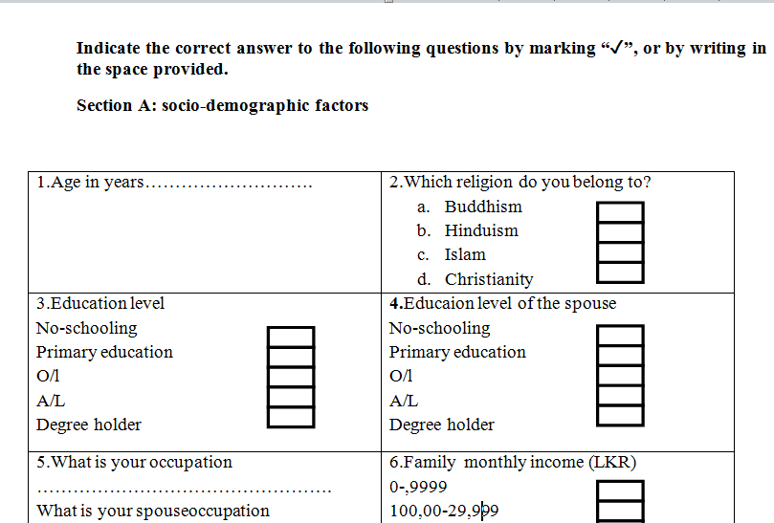
Materials and Methods cont.
Study Instruments

Slide 17
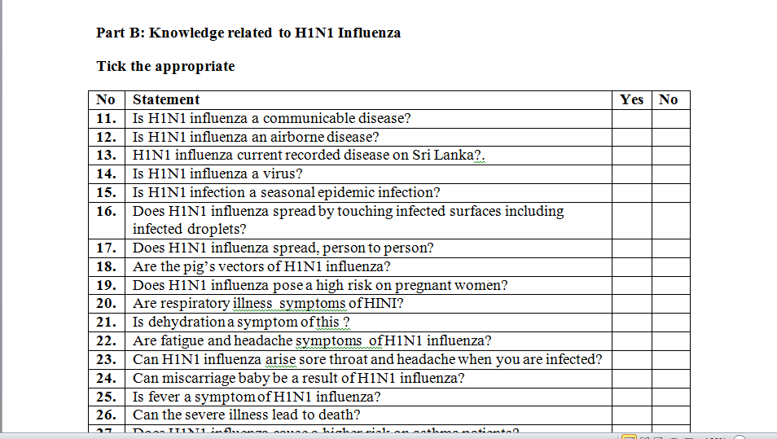
Materials and Methods cont.
Study Instruments

Slide 18
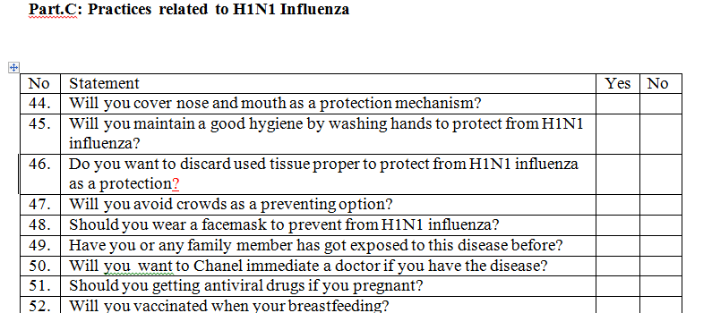
Materials and Methods cont.
Study Instruments

Slide 19
Materials and Methods cont.
Study Implementation Data collection
Obtaining of ethical and administrative clearance from PDHS, RDHS and MOH
Initiate data collection
Investigators will administer the study questionnaire in the clinics while the individuals are waiting for their turn
After obtaining their informed written consent the investigators will personally approach the participants and collect the data using the questioner

Slide 20
Materials and Methods cont.
Data analysis
IBM SPSS Statistics software package version 25
Descriptive statistics will be analysed using percentages, frequencies, mean, medians and standard deviation
Relationships will be analysed using bivariate analysis t test, chi square and correlation test will be done
Knowledge, and practice will be quantify using a scoring method

Slide 21
Materials and Methods cont.
Ethical and administrative clearance
Ethical clearance will be obtained from National Institute of Health Science (NIHS), Kalutara
Provincial Director of Health (North western)and Regional Director of Health services (Putalam)
MOH in Chilaw
Mid-wives/nurses working polyclinics

Slide 22
References
D'Alessandro, A., Napolitano, F., D'Ambrosio, A. and Angelillo, I. (2018). Vaccination knowledge and acceptability among pregnant women in Italy. Human Vaccines & Immunotherapeutics, 14(7), pp.1573-1579.
Ding, H., Santibanez, T., Jamieson, D., Weinbaum, C., Euler, G., Grohskopf, L., Lu, P. and Singleton, J. (2011). Influenza vaccination coverage among pregnant women–National 2009 H1N1 Flu Survey (NHFS). pp.S96-S106
Ditsungnoen, D., Greenbaum, A., Praphasiri, P., Dawood, F., Thompson, M., Yoocharoen, P., C. (2016). Knowledge, attitudes and beliefs related to seasonal influenza vaccine among pregnant women in Thailand. Vaccine, 34(18), pp.2141
Olatunbosun, O., Esterhuizen, T. and Wiysonge, C. (2017). A cross sectional survey to evaluate knowledge, attitudes and practices regarding seasonal influenza and influenza vaccination among diabetics in Pretoria, South Africa. Vaccine, 35(47), pp.6375-6386.
Wendlandt, R., Cowling, B., Chen, Y., Havers, F., Shifflett, P., Song, Y., Zhang, R., Iuliano, D., Xu, C., Yu, H., Zhang, J., Zhang, H., Tang, F. and Thompson, M. (2018). Knowledge, attitudes and practices related to the influenza virus and vaccine among older adults in Eastern China. Vaccine, 36(19), pp.2673-2682.
WHO (2019). WHO | WHO recommendations on pandemic (H1N1) 2009 vaccines.

Slide 23
Thank You

